Slide 1
The
Antebellum
South
By: Ms. Susan M. Pojer
Horace Greeley HS Chappaqua, NY

Slide 2
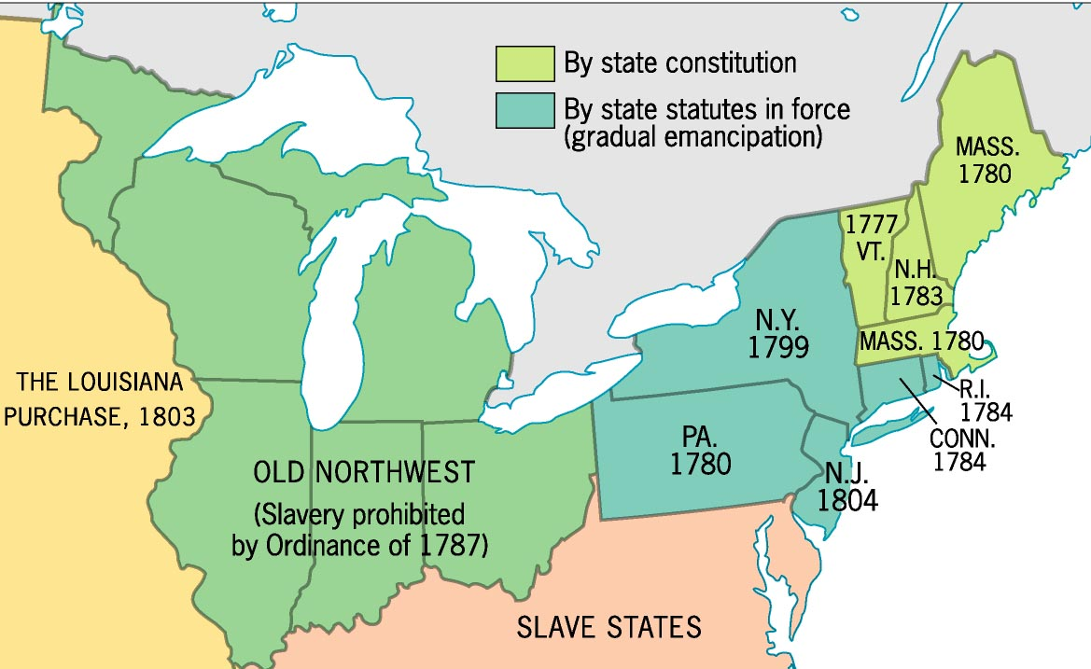
Early Emancipation in the North

Slide 3
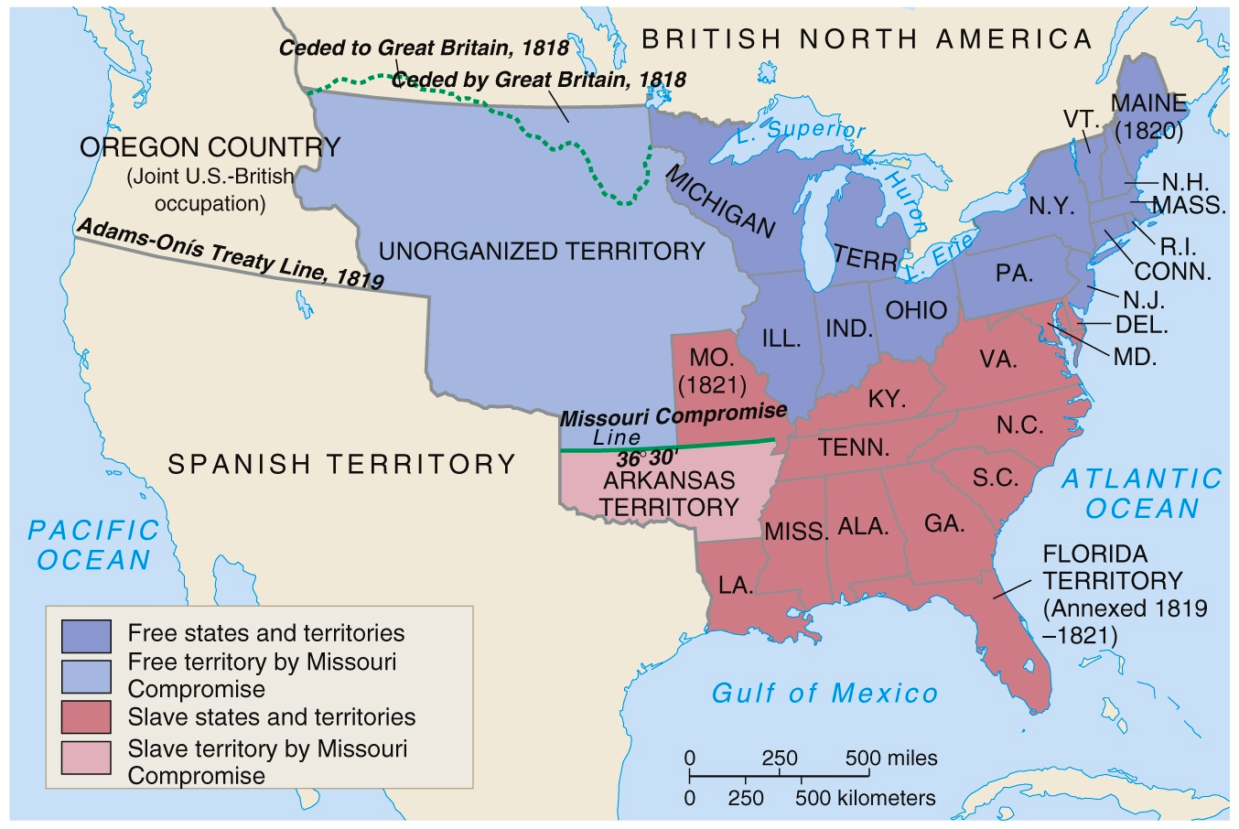
Missouri Compromise, 1820

Slide 4
Antebellum
Southern
Society

Slide 5
Characteristics of the Antebellum South
Primarily agrarian.
Economic power shifted from the
“upper South” to the “lower South.”
“Cotton Is King!”
* 1860→ 5 mil. bales a yr.
(57% of total US exports).
Very slow development of industrialization.
Rudimentary financial system.
Inadequate transportation system.

Slide 6
Southern Society (1850)
“Slavocracy”
[plantation owners]
6,000,000
The “Plain Folk”
[white yeoman farmers]
Black Freemen
250,000
Black Slaves
3,200,000
Total US Population → 23,000,000
[9,250,000 in the South = 40%]

Slide 7
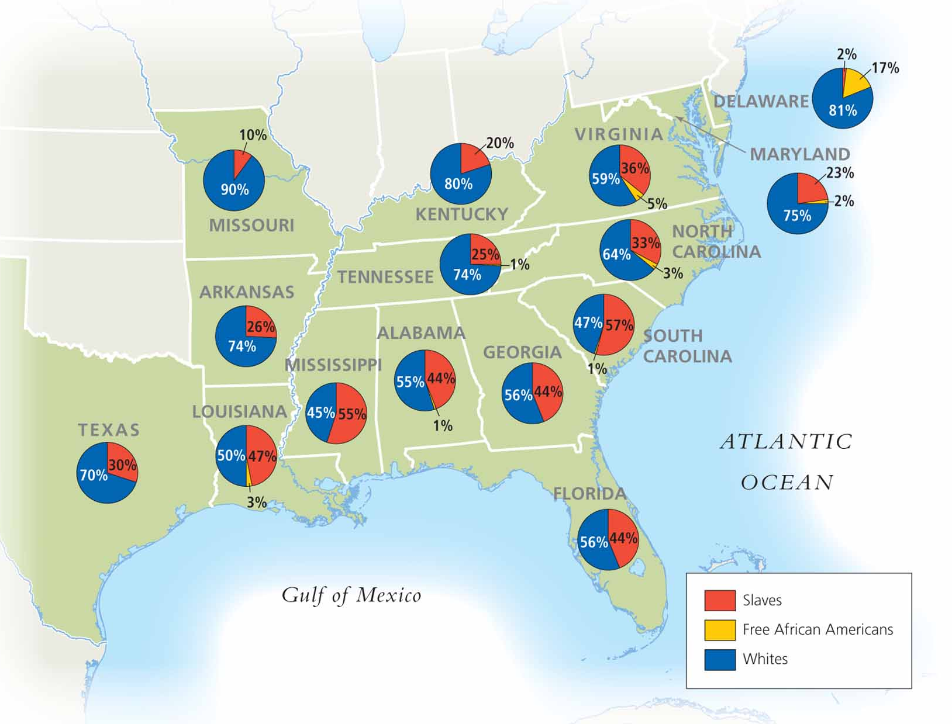
Southern Population

Slide 8
Antebellum
Southern
Economy

Slide 9
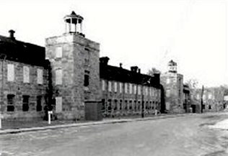
Graniteville Textile Co.
Founded in 1845, it was the South’s first attempt at industrialization in Graniteville, SC.

Slide 10
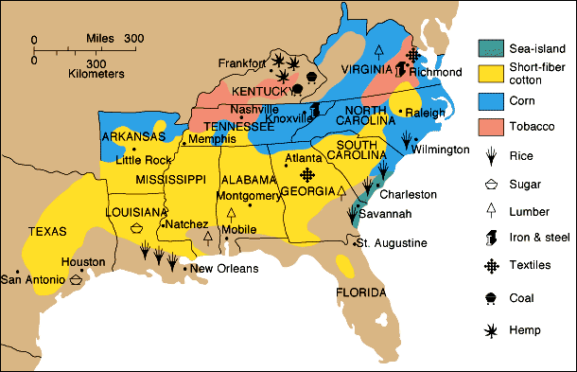
Southern Agriculture

Slide 11
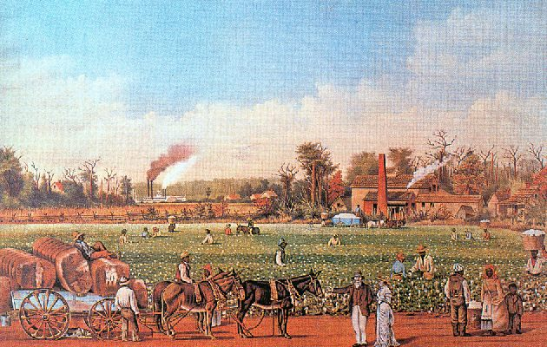
Slaves Picking Cotton
on a Mississippi Plantation

Slide 12
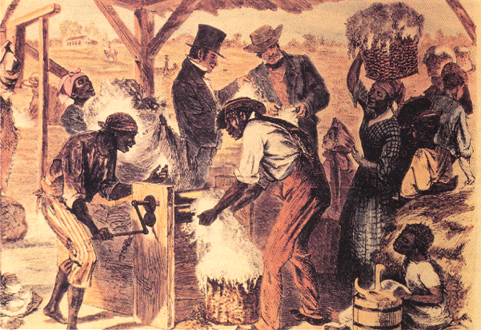
Slaves Using the Cotton Gin

Slide 13
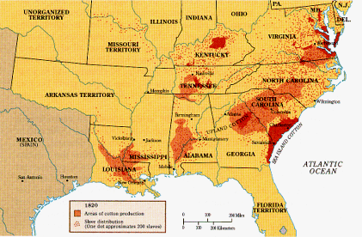
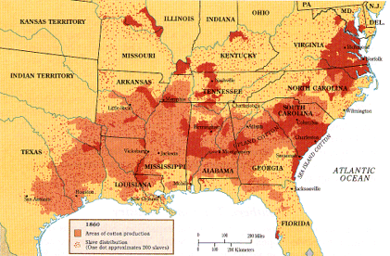
Changes in Cotton Production
1820
1860

Slide 14
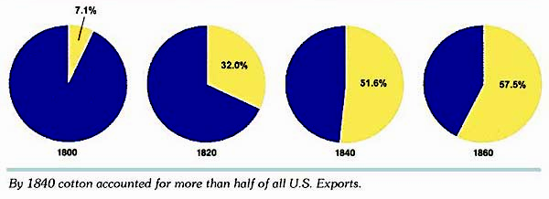
Value of Cotton Exports
As % of All US Exports

Slide 15
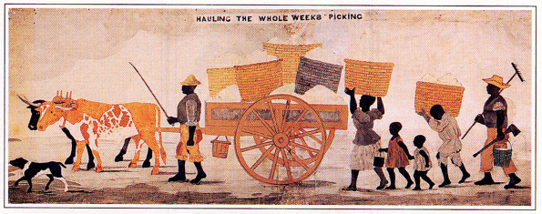
“Hauling the Whole Week’s Pickings”
William Henry Brown, 1842

Slide 16
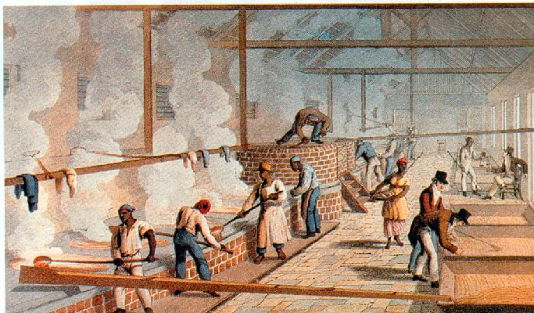
Slaves Working
in a Sugar-Boiling House, 1823

Slide 17
The South's
"Peculiar
Institution"

Slide 18
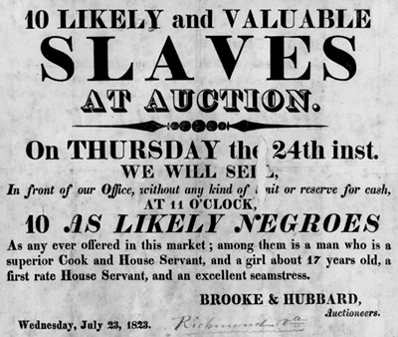
Slave Auction Notice, 1823

Slide 19
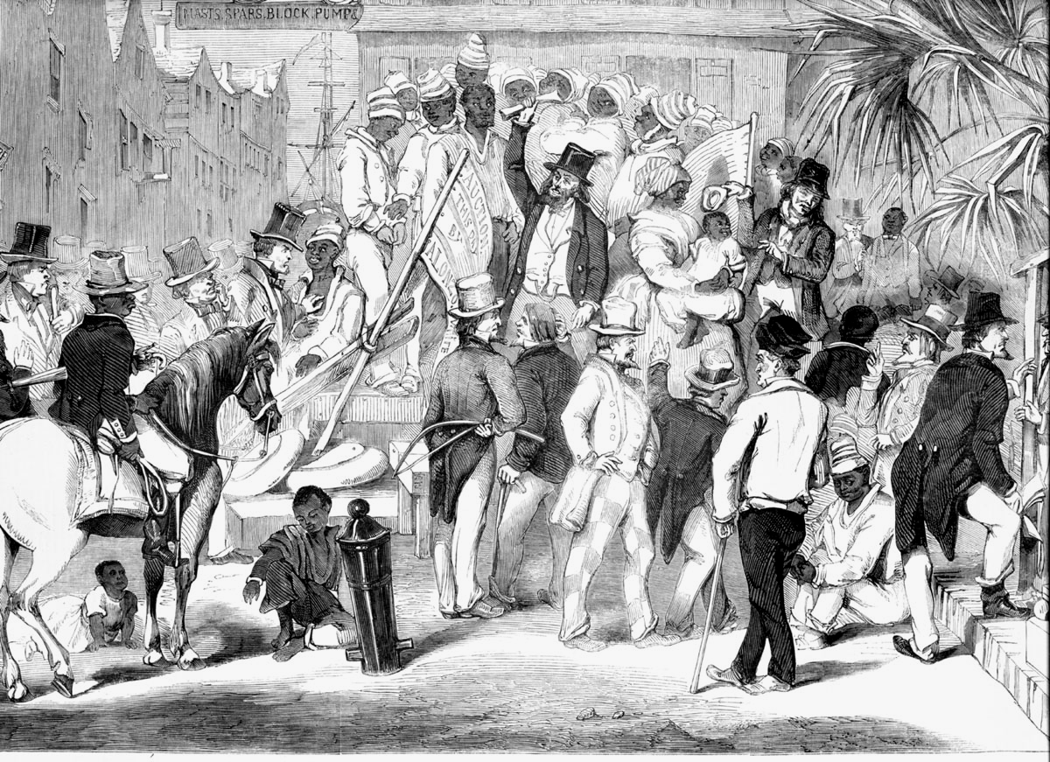
Slave Auction: Charleston, SC-1856

Slide 20
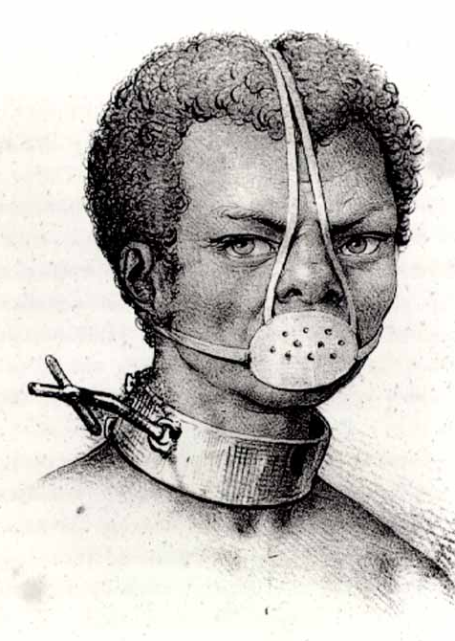
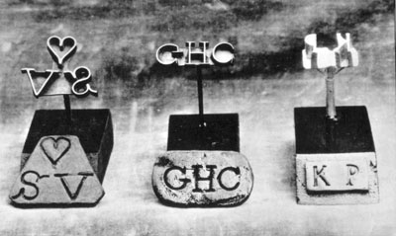
Slave Accoutrements
Slave Master
Brands
Slave muzzle

Slide 21
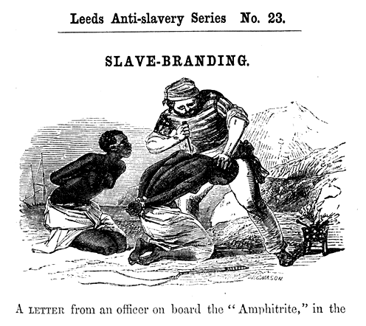
Anti-Slave Pamphlet

Slide 22
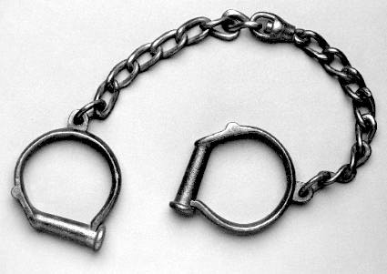
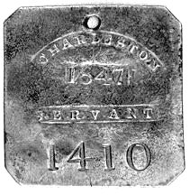
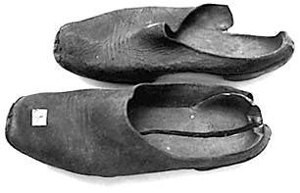
Slave Accoutrements
Slave leg irons
Slave tag, SC
Slave shoes

Slide 23
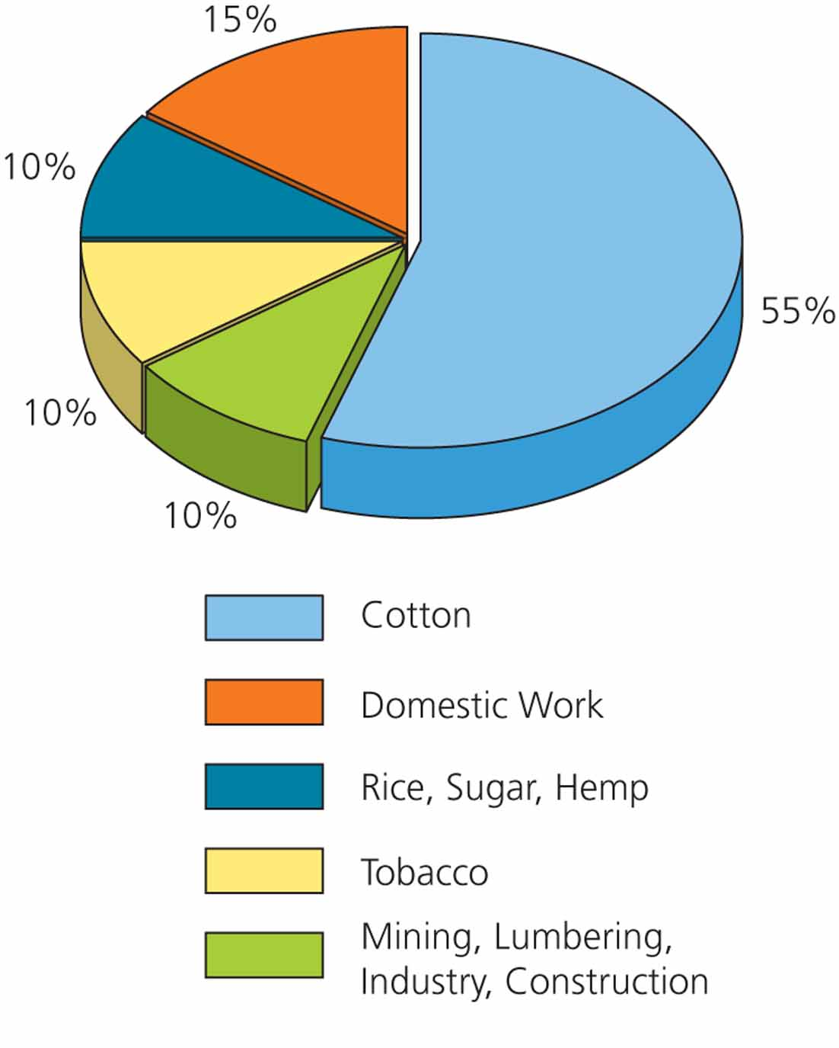
Distribution of Slave Labor in 1850

Slide 24
Antebellum
Southern
Plantation Life

Slide 25
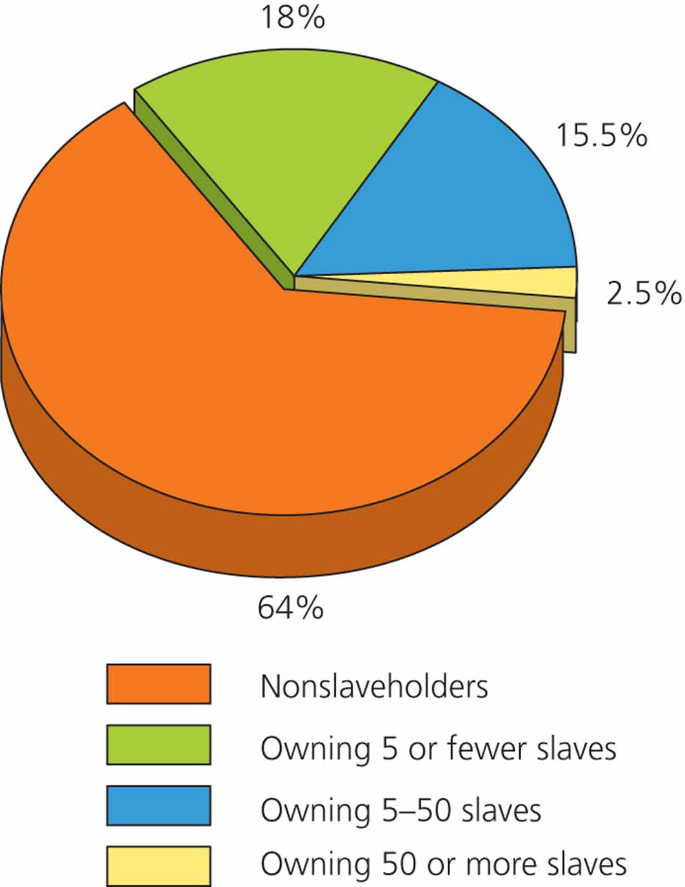
Slave-Owning Population (1850)

Slide 26
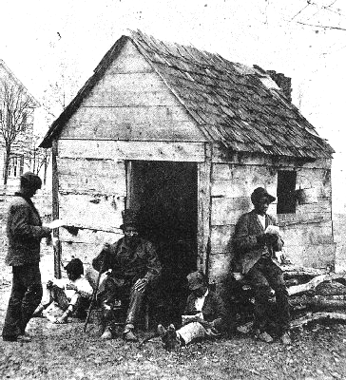
Slaves posing in front of their cabin on a Southern plantation.

Slide 27
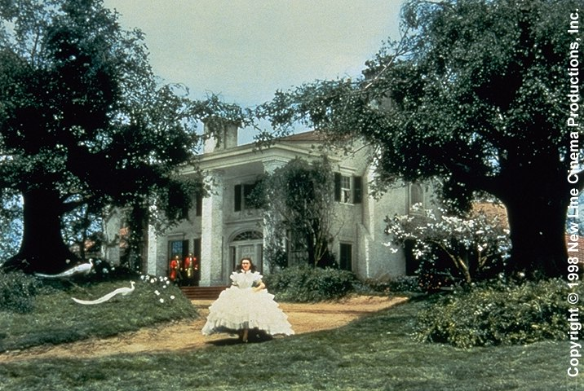
Tara – Plantation Reality or Myth?
Hollywood’s Version?

Slide 28
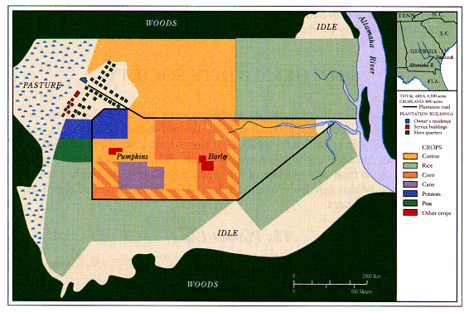
A Real Georgia Plantation

Slide 29
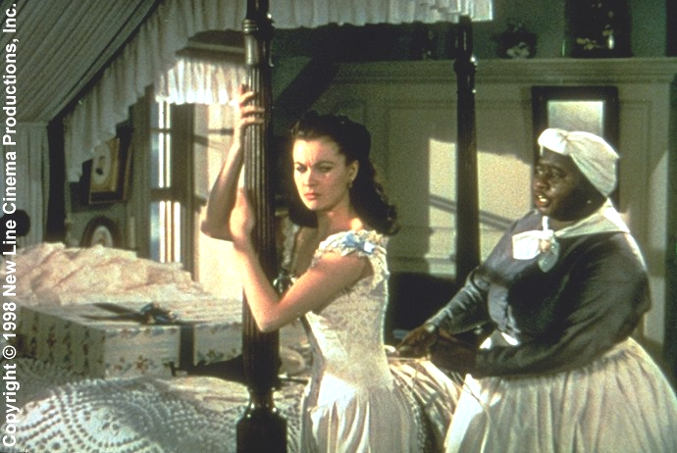
Scarlet and Mammie
(Hollywood Again!)

Slide 30
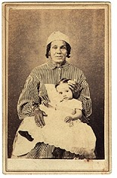
A Real Mammie & Her Charge

Slide 31
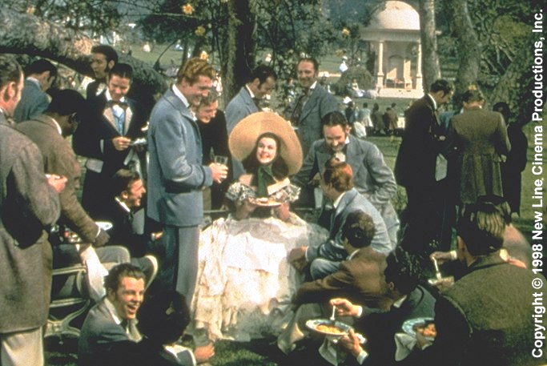
The Southern “Belle”

Slide 32
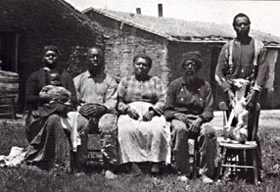
A Slave Family

Slide 33
The Ledger of John White
Matilda Selby, 9, $400.00 sold to Mr. Covington, St. Louis, $425.00
Brooks Selby, 19, $750.00 Left at Home – Crazy
Fred McAfee, 22, $800.00 Sold to Pepidal,
Donaldsonville, $1200.00
Howard Barnett, 25, $750.00 Ranaway. Sold out of jail, $540.00
Harriett Barnett, 17, $550.00 Sold to Davenport and Jones, Lafourche, $900.00

Slide 34
US Laws Regarding Slavery
U. S. Constitution:
* 3/5s compromise [I.2]
* fugitive slave clause [IV.2]
1793 → Fugitive Slave Act.
1850 → stronger Fugitive Slave Act.

Slide 35
Southern Slavery--> An Aberration?
1780s: 1st antislavery society created in Phila.
By 1804: slavery eliminated from last northern state.
1807: the legal termination of the slave trade, enforced by the Royal Navy.
1820s: newly indep. Republics of Central & So. America declared their slaves free.
1833: slavery abolished throughout the British Empire.
1844: slavery abolished in the Fr. colonies.
1861: the serfs of Russia were emancipated.

Slide 36
Slavery Was Less Efficient
in the U. S. than Elsewhere
High cost of keeping slaves from
escaping.
GOAL → raise the “exit cost.”
Slave patrols.
Southern Black Codes.
Cut off a toe or a foot.

Slide 37
Slave
Resistance
&
Uprisings

Slide 38
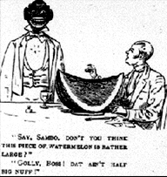
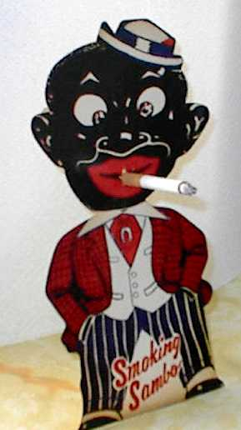
Slave Resistance
“SAMBO” pattern of behavior used as a
charade in front of whites [the innocent, laughing black man caricature – bulging eyes, thick lips, big smile, etc.].

Slide 39
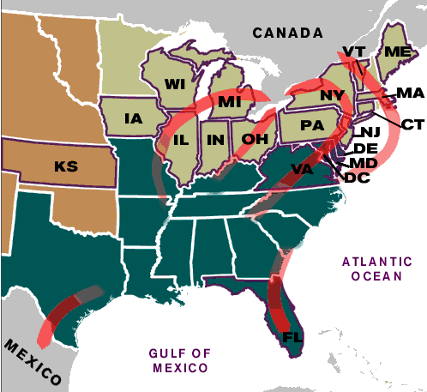
Slave Resistance
Refusal to work hard.
Isolated acts of sabotage.
Escape via the Underground Railroad.

Slide 40
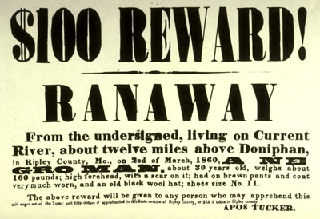
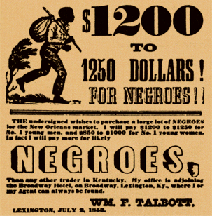
Runaway Slave Ads

Slide 41

Quilt Patterns as Secret Messages
The Monkey Wrench pattern, on the left, alerted escapees to gather up tools and prepare to flee; the Drunkard Path design, on the right, warned escapees not to follow a straight route.

Slide 42
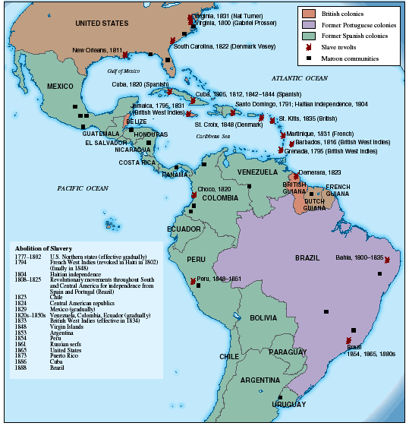
Slave Rebellions Throughout the Americas

Slide 43
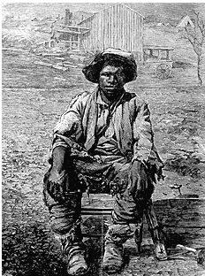

Slave Rebellions
in the Antebellum South
Gabriel Prosser
1800
1822

Slide 44
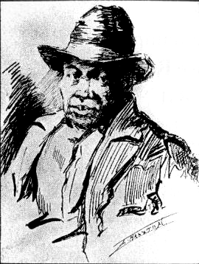
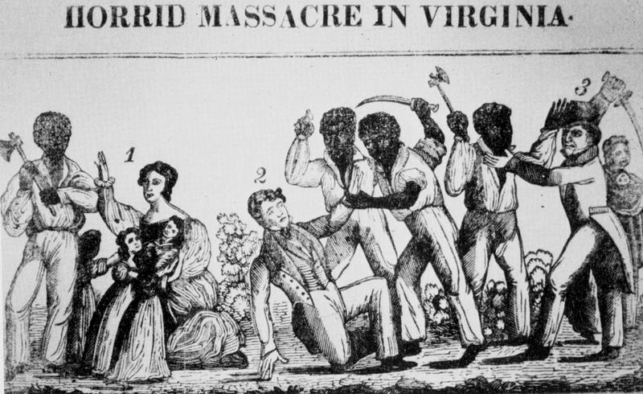
Slave Rebellions in the Antebellum South:
Nat Turner, 1831

Slide 45
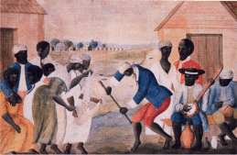
The Culture of Slavery
Black Christianity [Baptists or Methodists]:
* more emotional worship services.
* negro spirituals.
“Pidgin” or Gullah languages.
Nuclear family with extended kin links,
where possible.
Importance of music in their lives. [esp. spirituals].

Slide 46
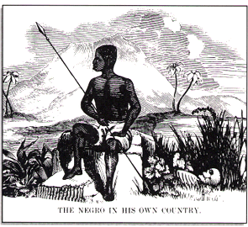
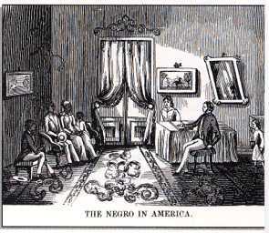
Southern Pro-Slavery
Propaganda

